Slide 1
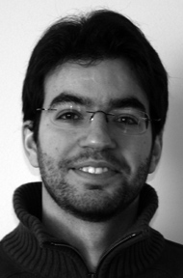
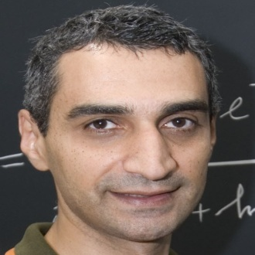
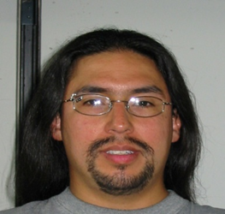
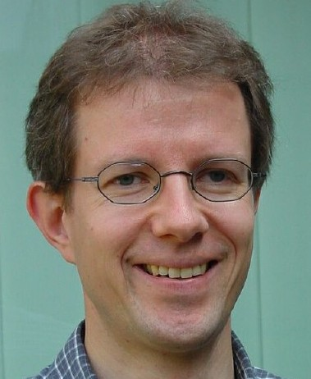
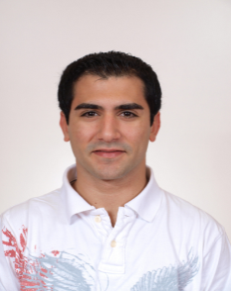
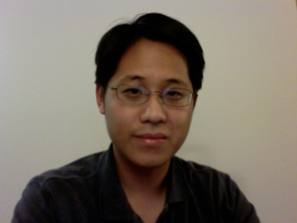

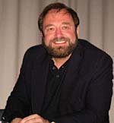
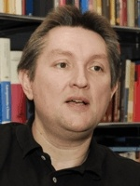
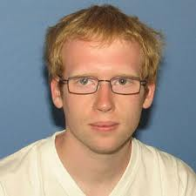

How to enhance Tc in nano-structured materials
Antonio M. García-García
Cavendish Laboratory, Cambridge University, Lisbon University
http://www.tcm.phy.cam.ac.uk/~amg73/
Yuzbashyan
Rutgers
Urbina
Regensburg
Richter Regensburg
Pedro Ribeiro Dresden
Bermudez
Cambridge
Way
Santa Barbara
Sangita Bose Bombay
Altshuler Columbia
Klaus Kern Stuttgart
Mayoh
Cambridge

Slide 2

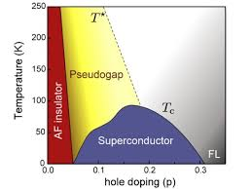

Superconductivity
Mavericks
Quantum critical points ©
Cuprates ~100K 1986 Mueller & Bednorz
MgB₂ 39K 2001 Akimitsu
FeSC ~50K 2006 Hotsono

Slide 3
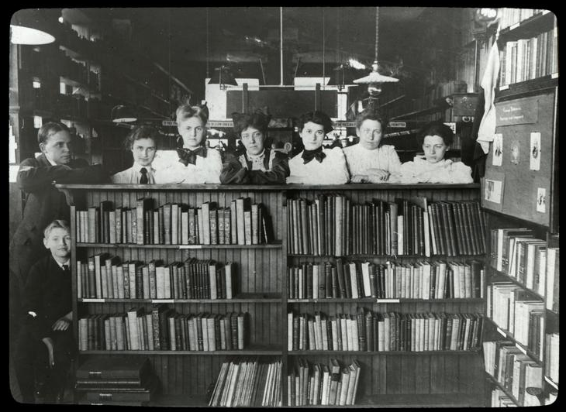
Pb ~7K Al ~1K Sn ~3.7K Nb ~9.3K
Librarians
Thinner
Cleaner
Smaller
Granular
BCS + ….
Abeles, Tinkham, Devoret, Goldman, Xue, Kern, Di Fazio, Schoen, Halperin, Leggett,Blatt….
Thin films
Josephson Junctions
Control
Nanowires

Slide 4
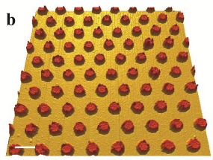
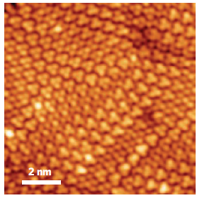
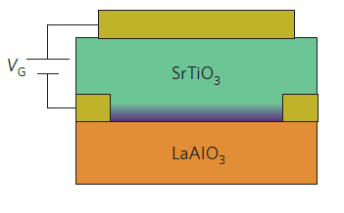
7 nm
Smaller
0 nm
Higher
T_{c}?
Far from equilibrium
Grainy
Packed

Slide 5
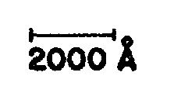
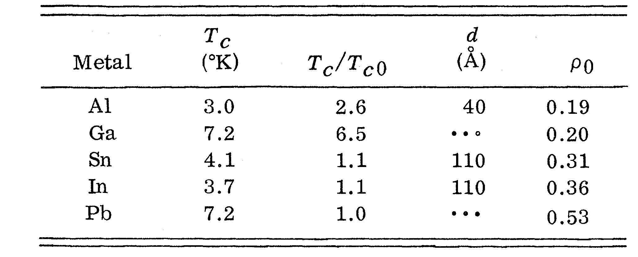
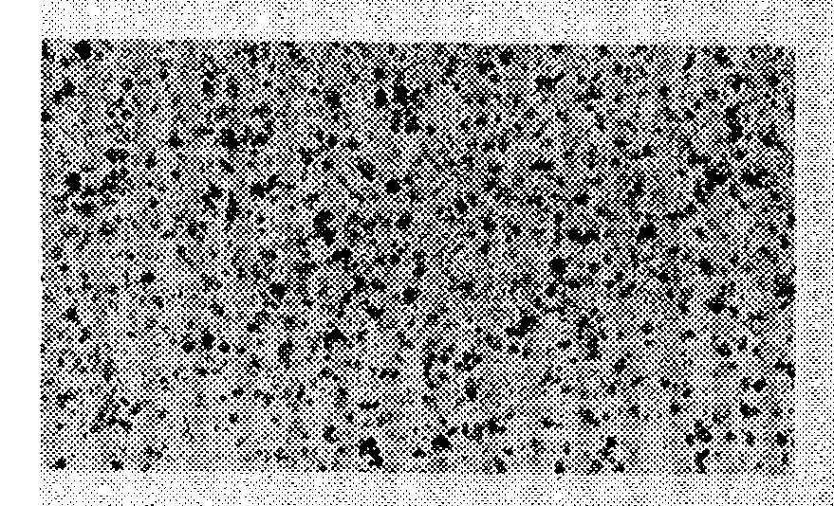
Thin Films?
Abeles, Cohen, Cullen, Phys. Rev. Lett., 17, 632 (1966)
Crow, Parks, Douglass, Jensen, Giaver, Zeller....
A.M. Goldman, Dynes, Tinkham…

Slide 6
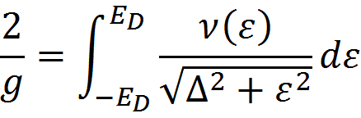
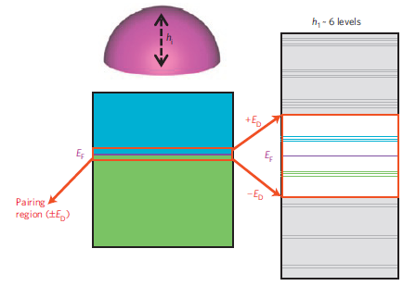
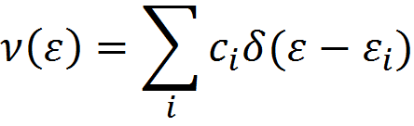
BCS superconductivity
Finite size effects
V → ∞ Δ~ ε_{D}e^{-1/λ}
V finite Δ=?
Level Degeneracy
Shell Effects
Parmenter, Phys. Rev. 166, 392 (1967)
L ~ 5nm
20T_{c}!

Slide 7
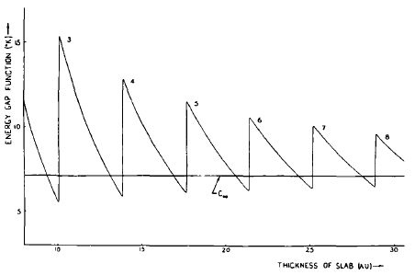
Thin Films
Shape Resonances
10T_{c}!
Fluctuations?
Charge neutrality?
Substrate?
Blatt, Thompson, Phys. Lett. 5, 6 (1963)
Yu, et al.,Rev. B 14, 996 (1976)
Bermudez, AGG, Phys. Rev. B 89, 064508 (2014) 89, 024510 (2014)

Slide 8
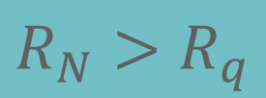
Thinner
Smoother
Disordered
BKT
Transition
$$R_{N}>R_{q}$$
(anti)Vortex unbinding
A.M. Goldman et al.
PRL 62 2180 (1989)
PRB 47 5931 (1993)

Slide 9
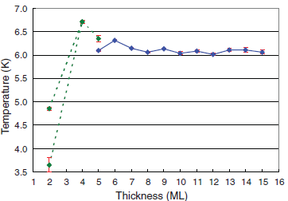
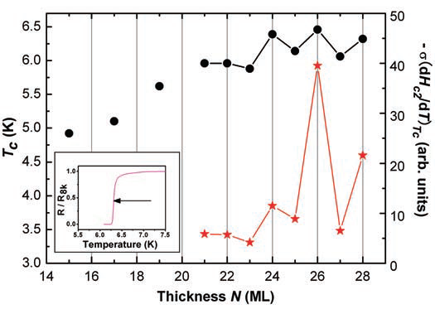
2000
Atomic scale control
Pb
Shih et al., Science 324, 1314 (2009)
Xue et al., Science 306, 1915 (2004)
Size effects but not higher Tc

Slide 10
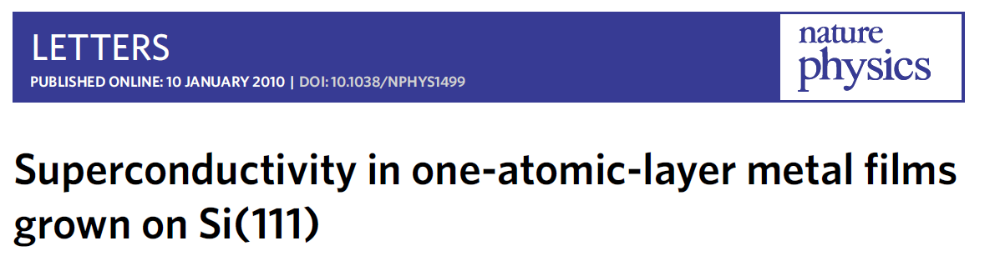
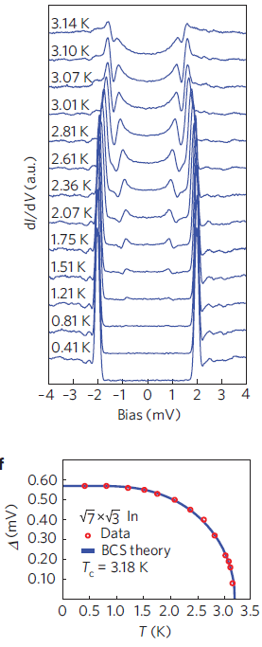
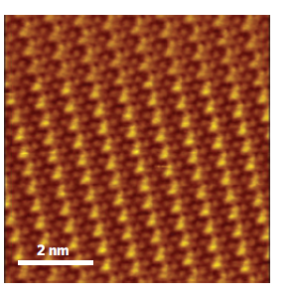
Epitaxial growth
STM
No impurities

Slide 11
Is enhancement of superconductivity possible?

Slide 12
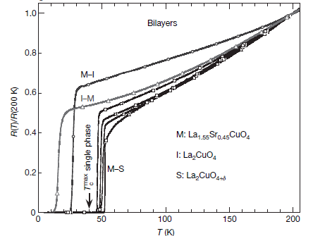
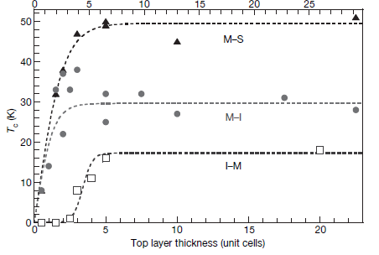
Cuprates high T_{c} Heterostructures
Bozovic et al., Nature 455, 782 (2008)
Higher T_{c}!!

Slide 13
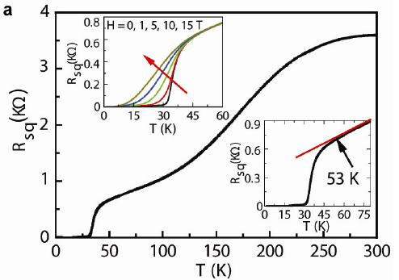
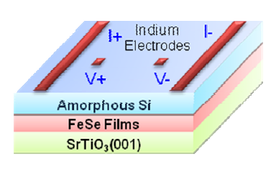
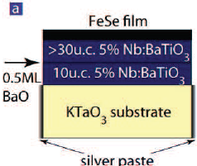
Iron Based Heterostructures
Xue et al., Nature Communications 3, 931 (2013)
Feng, et. al, arXiv:1402.1357

Slide 14
Enhancement, yes
Origin?
Grains

Slide 15
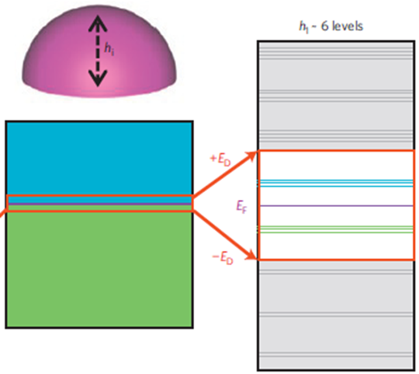
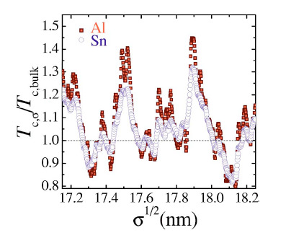
Δ >> δ
Grains
Heiselberg (2002): harmonic potentials, cold atom
Kresin, Ovchinnikov, Boyaci (2007) : Spherical, too high T_{c}
Peeters, et al, (2005-): BCS, BdG in a wire, cylinder..
Devreese (2006): Richardson equations in a box
Olofsson (2008): Estimation of fluctuations in BCS

Slide 16
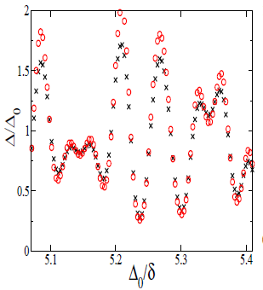


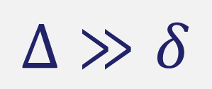
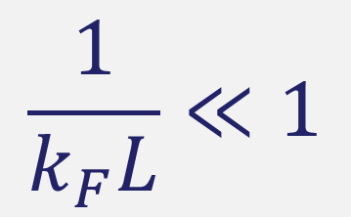
3d chaotic
$$Δ≫δ$$
Al grain
k_{F} = 17.5 nm⁻¹
Δ₀ = 0.24mV
$$\frac{1}{k_{F}L}≪1$$
3d integrable
PRL 100, 187001 (2008) PRB 83, 014510 (2011)

Slide 17
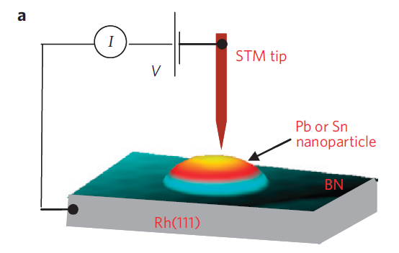
Single, Isolated Sn and Pb grains
7 nm
Kern
Bose
R ~ 4-30nm
A gap is still observed
0 nm
Almost hemispherical
STM
Tunneling conductance

Slide 18
+
Bose, AGG, Nature Materials 2010

Slide 19
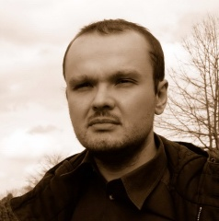
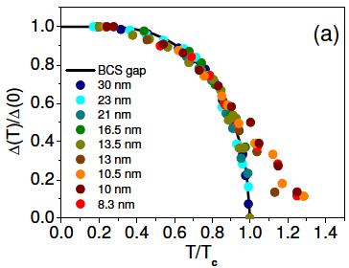
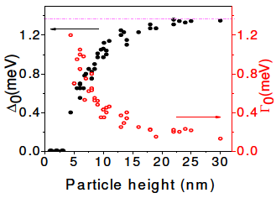
More fun?
Why not
Ribeiro, Dresden
Pb
Beyond mean field

Slide 20
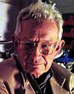
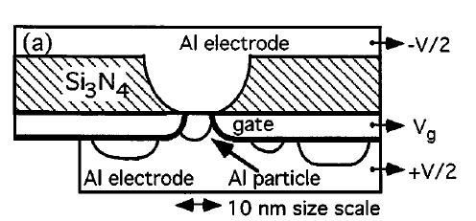
Δ ~ δ
Ralph, Black,Tinkham, Superconductivity in Single Metal Particles PRL 74, 3241-3244 (1995).
Superconductivity?
1959
Yes, superconductivity
B closes gap
Odd-even effects
Isolated grain?

Slide 21
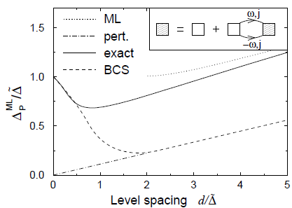
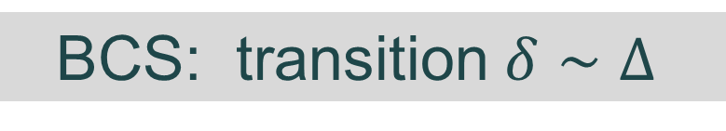
T = 0
δ/ Δ₀ ~ 1
Richardson’s BCS exact solution
J. von Delft et al., Phys. Rep., 345, 61 (2001)
T≠0
BCS fine until δ/ Δ₀ ~ 1/2
BCS: transition $δ∼Δ$
Path Integral
Richardson: only crossover
Static Path Approach
von Delft, Braun, Larkin, Sierra, Dukelsky, Yuzbashyan, Matveev, Smith, Ambegaokar
Scalapino, et al.,70’s

Slide 22
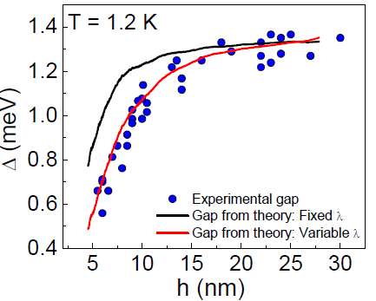
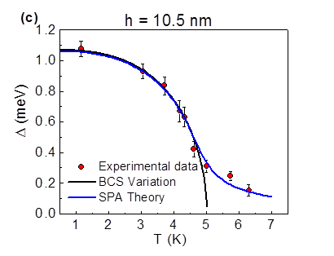
Quantum Fluctuations
Richardson’s equations
and
Thermal Fluctuations
Static Path Approach
PRB 84,104525 (2011)
Editor‘s Suggestion

Slide 23
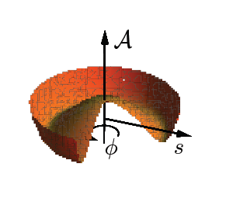
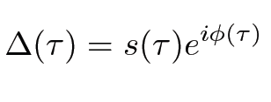
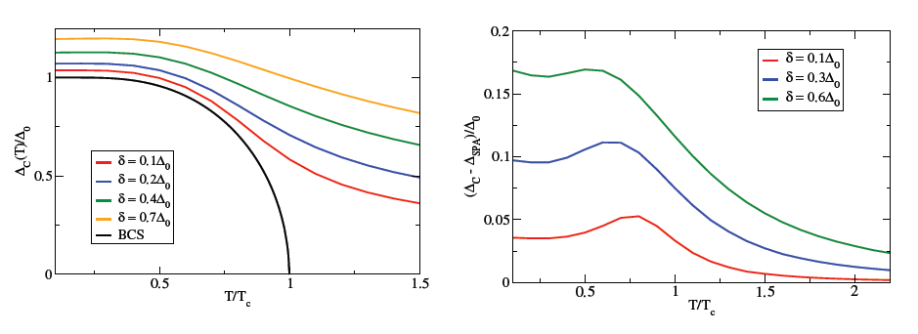
Quantum + Thermal?
T, δ/ Δ₀ << 1
Divergences at intermediate T
Rossignoli and Canosa
Ann. of Phys. 275, 1, (1999)
Harmful Zero Modes
Polar coordinates
Quantum fluctuations ~ Charging effects
Ribeiro and AGG, Phys. Rev. Lett. 108, 097004 (2012)

Slide 24


True phase coherence in single nanograins?
No
$$ΔNΔφ≥ℏ$$
Josephson
array?
Maybe
Mason, et al, Nature Physics 8 59 (2012)

Slide 25


Al evaporated on a glass substrate
Deutscher 73’

Slide 26

Engineering granular materials
Optimal but realistic
Size
Variance
Packing
Tc=1.3Tc^{bulk}
Tc=1.5Tc^{bulk}
Tc=3.0Tc^{bulk}!!!
Mayoh, AGG, arXiv:1311.0295

Slide 27

7nm
$$T≫T_{c}^{bulk}$$

Slide 28

$$T≥T_{c}^{bulk}$$

Slide 29



What?
Nano spheres
3D
Clean
R: $\sim 1nm$
Quasi particle tunnelling
$$\overline{R}≥4nm$$
JJ array
Capacitance
How?
Open grain
JJ Array
BCS
Mean field
Semiclassical
Percolation

Slide 30


Single grain
Tunneling
Smooth DOS
Open grain
Weaker size effects

Slide 31








3D Array
I
N
H
O
M
O
G
E
N
E
O
U
S
Schoen, Zaikin,Fazio..
H
O
M
O
G
E
N
E
O
U
S
D_{p} ~ 2.55
T
#SCG
T_{c} ?

Slide 32
Wait!
Percolation?
T_{c}
T
Mean field?
#SCG

Slide 33



$$σ=0.1, 0.6, 1, 1.4 nm$$
$$\overline{R}=5nm λ=0.25$$

Slide 34




$$λ=0.2, 0.25, 0.3, 0.35$$
$$σ=1 nm$$
$$\overline{R}=5 nm$$

Slide 35




$$Packing=Cubic,BCC,FCC$$
$$σ=1 nm$$
$$\overline{R}=5 nm$$
$$λ=0.25$$
Enhancement is possible!
Experiments?

Slide 36
Other ways to enhance Tc

Slide 37

LaAlO₃ /SrTiO₃
Heterostructures
Control &Tunability
Spin-Orbit
Disorder
Magnetism
E Field effect
Relevance
Localization
Triscone, Nature 456 624 (2008)
Exotic Quantum Matter
Lesueur, arXiv:1112.2633
PRL 104, 126803 (2010)
PRB 85, 020457 (2012)
Topology

Slide 38


Mocking Cuprates
Electric Field Effect
+
2D LTO/STO
Pseudogap
Higher Tc by coupling to a metallic layer?
Mannhart et al., Nature 502, 528 (2013)

Slide 39


Graphene
+
Granular Sn
Sn
Stabilization of SC fluctuations?
Allain, Bouchiat, et al., Nat. Mat. 11, 590 (2012)

Slide 40



Transient Superconductivity
Pump & Probe
Femtosecond Pulses
ARPES

Slide 41
How to enhance?
Engineering of nano-structured materials
Suppresion of phase fluctuations by controlled coupling.
Steady non-thermal superconductivity

Slide 42
+Experimental control
1966
1995
+Predictive power
7 nm
Now
0 nm
Engineering of high T_{c} materials
?

Slide 43
Danke!

