Slide 1
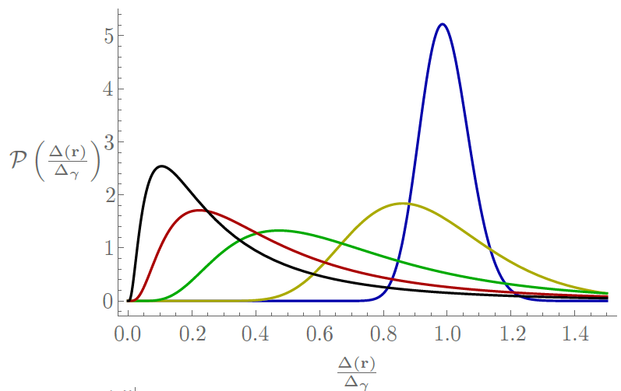
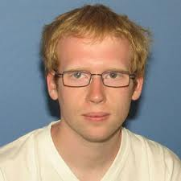
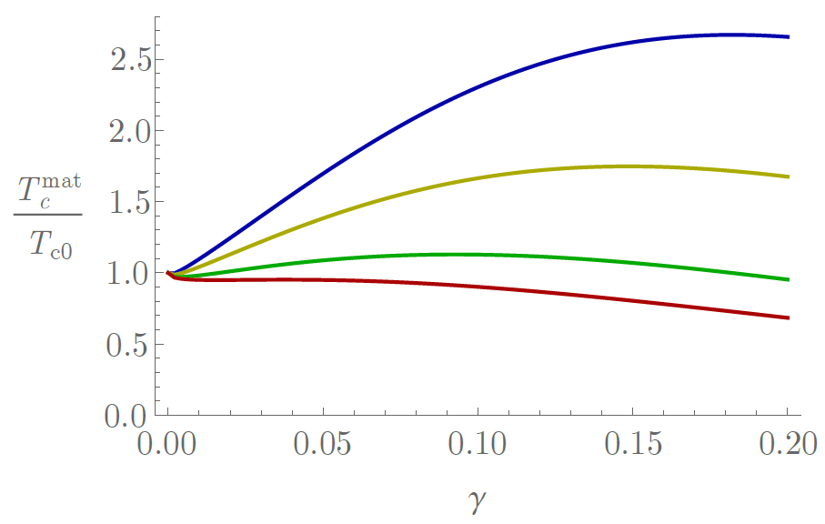

Global critical temperature in inhomogeneous superconductors induced by multifractality
Antonio M. García-García
Cavendish Laboratory, Cambridge University
http://www.tcm.phy.cam.ac.uk/~amg73/
James Mayoh
Mayoh. AGG, Phys. Rev. B 92, 174526 (2015)

Slide 2
Disorder and superconductivity
Anderson Theorem
Gorkov, Anderson 50’s
(Do not worry about disorder)
Localization and SC can coexist
Ma, Lee, Sadovskii 80’s
Weak localization weakens SC
Maekawa, Finkelstein 80’s
Numerical BdG
Emergent granularity
Trivedi et al., Meir 90’s
Pseudogap, Goldstone, Higgs modes, gap distribution function
Sacepe, Raychaudhuri,Brun, Roditchev, Benfatto, Castellani, Feigelmann
Multifractal disorder
Kravtsov, Mirlin

Slide 3
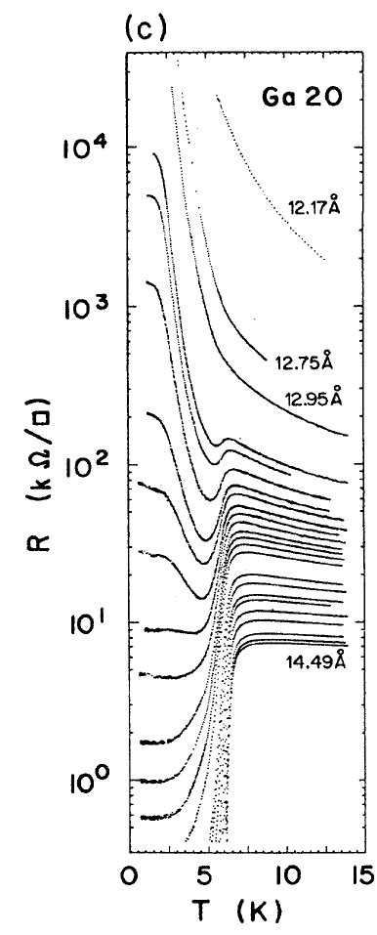
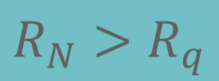
Superconductor – Insulator transition
Thinner
Fluctuating
Disordered
BKT
Transition
$$R_{N}>R_{q}$$
(anti)Vortex unbinding
A.M. Goldman et al.
PRL 62 2180 (1989)
PRB 47 5931 (1993)

Slide 4
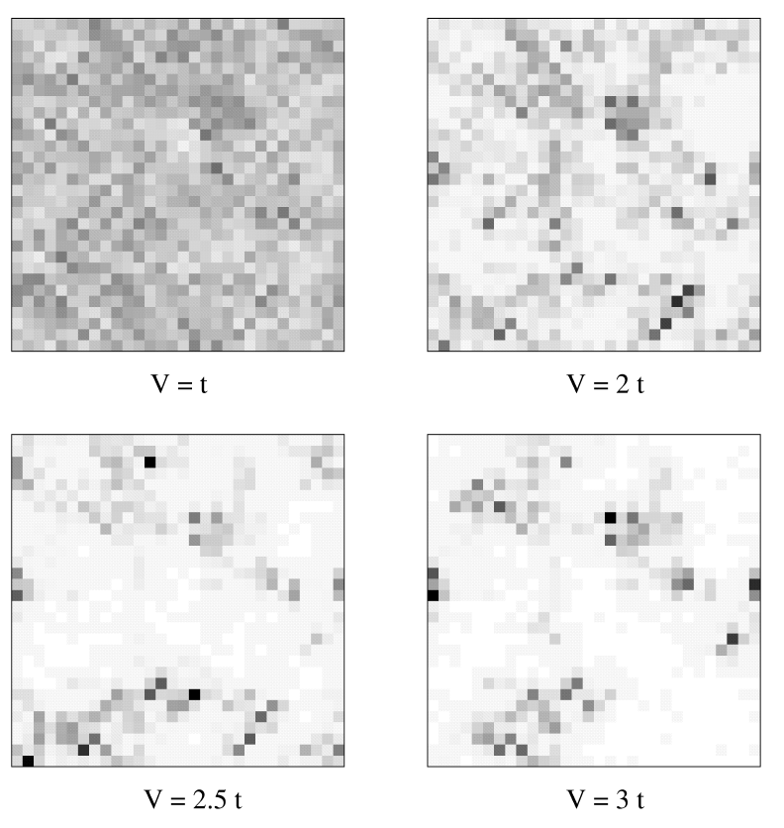
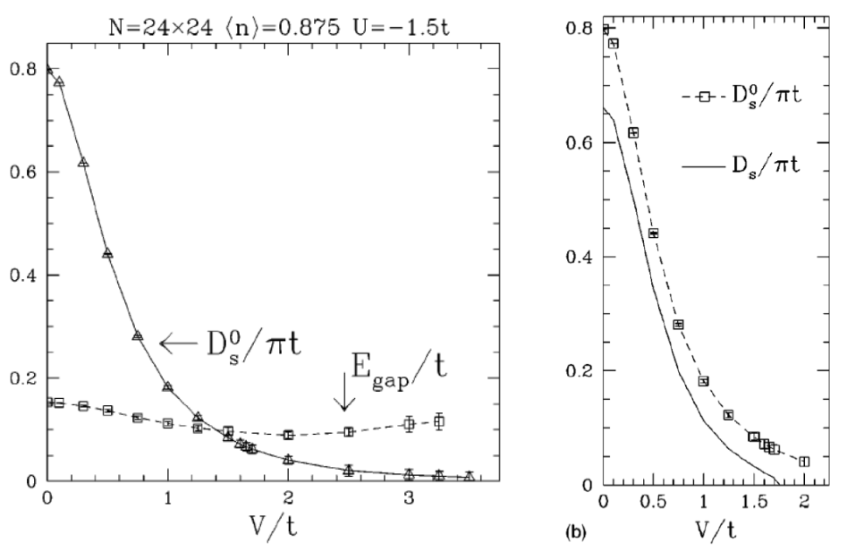
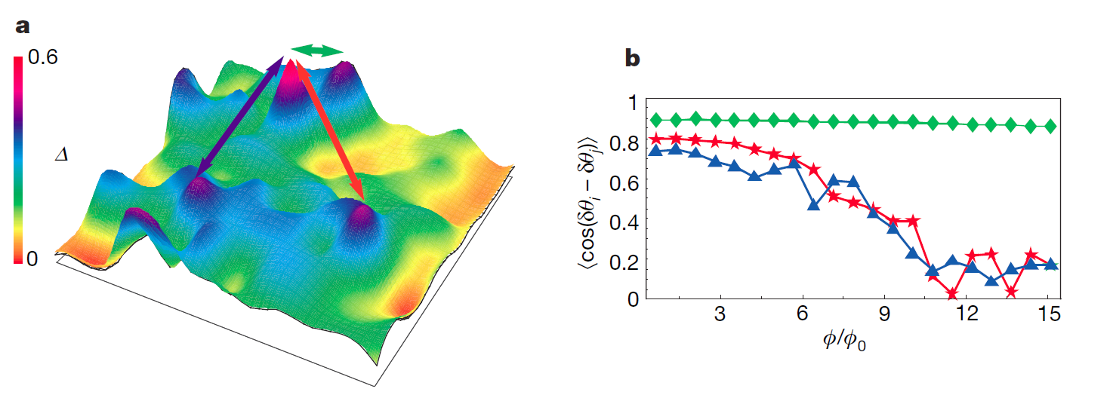
Emergent granularity of disordered superconductors
Ghosal, Randeria,Trivedi
Phys. Rev. B 65, 014501 (2001)
Dubi et al., Nature 449 876 (2007)

Slide 5
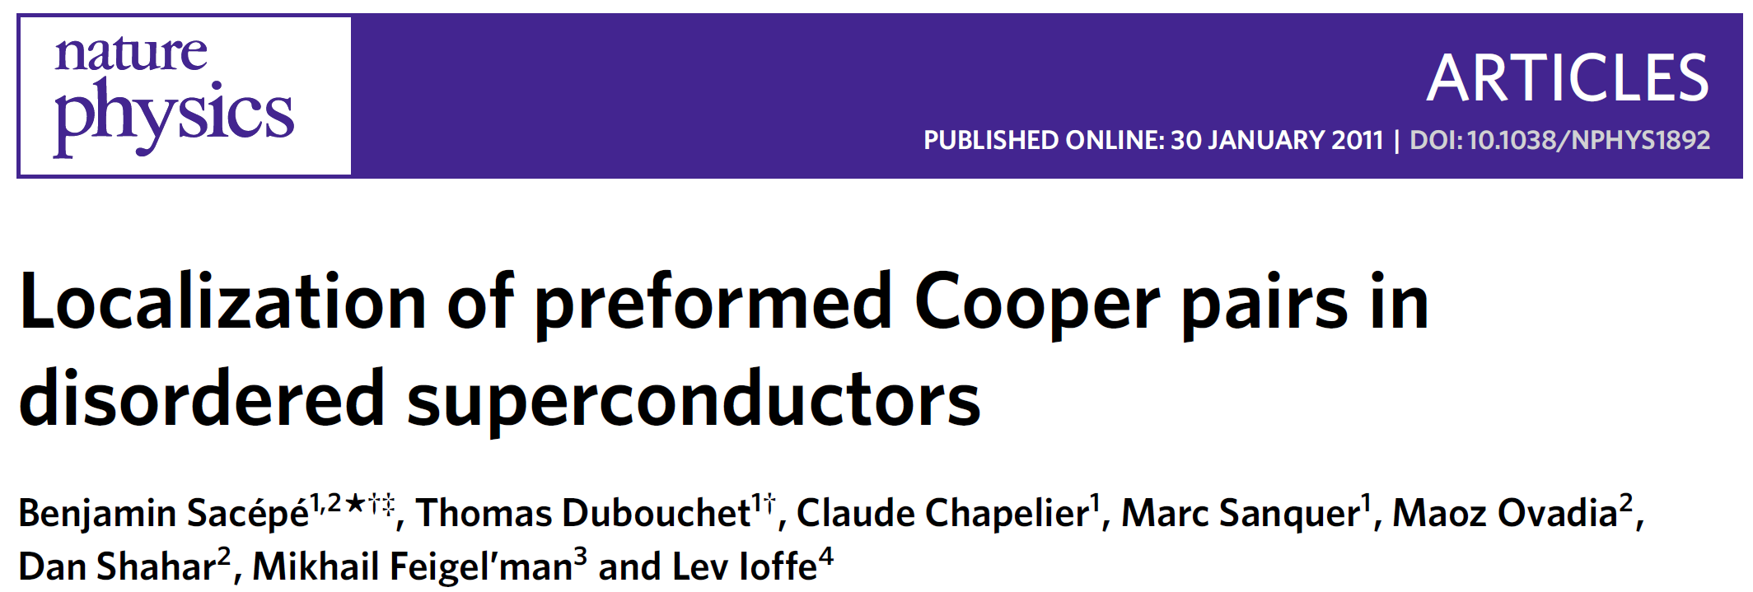
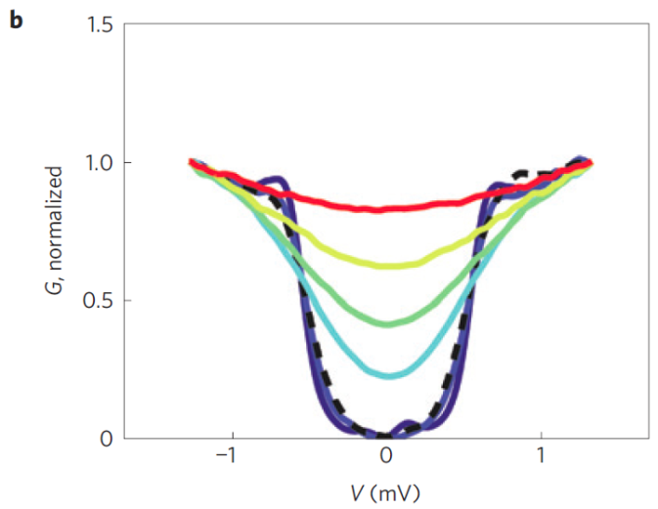
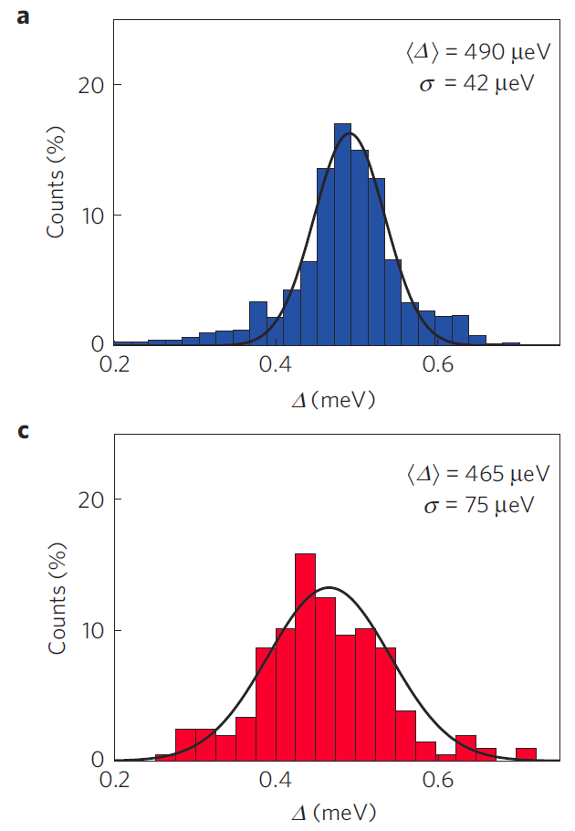
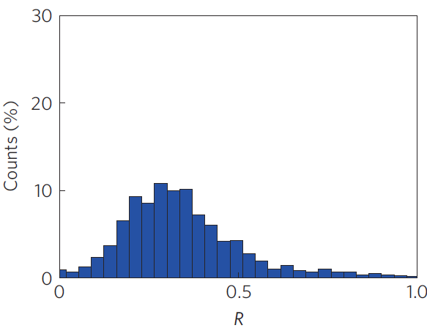
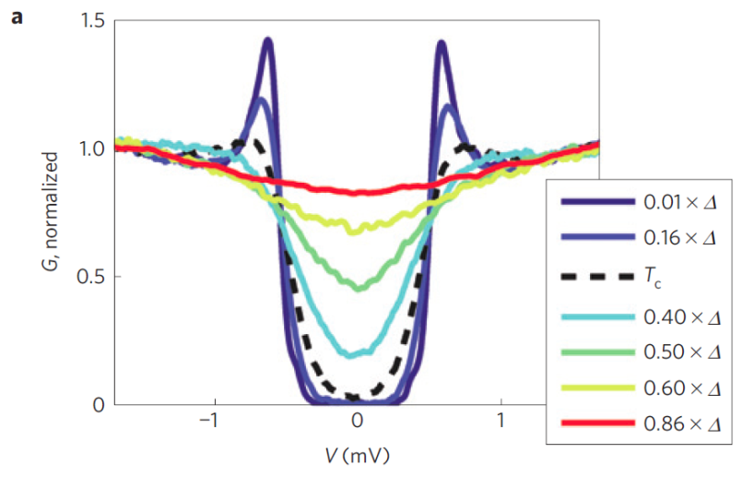
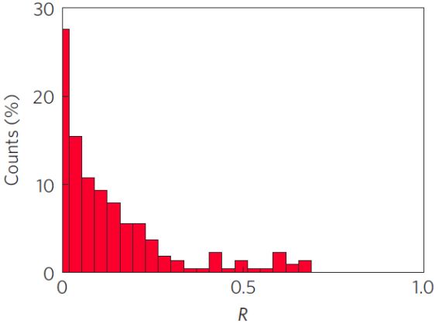
Cooper’s pairs localization
Broad distribution

Slide 6
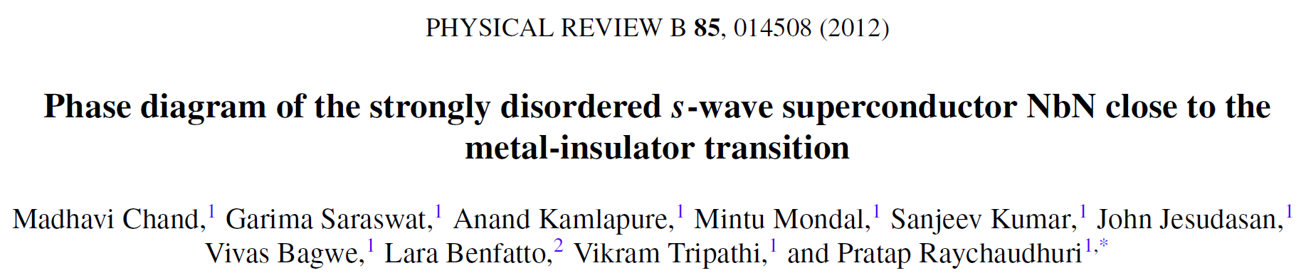
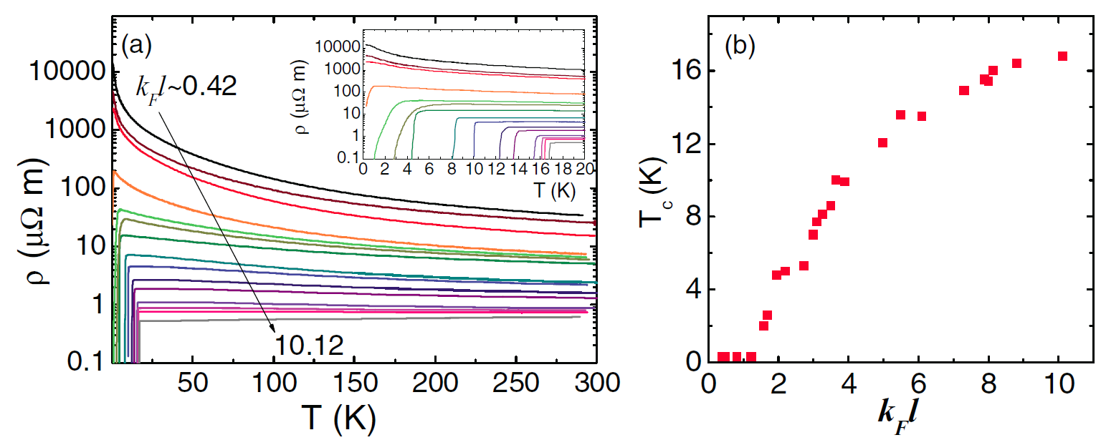
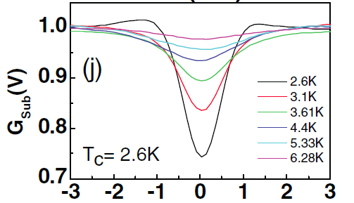
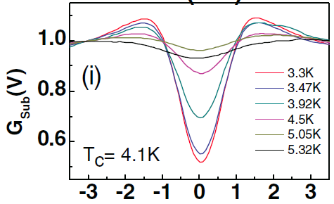

Slide 7
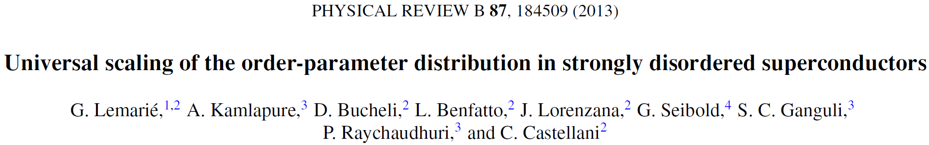
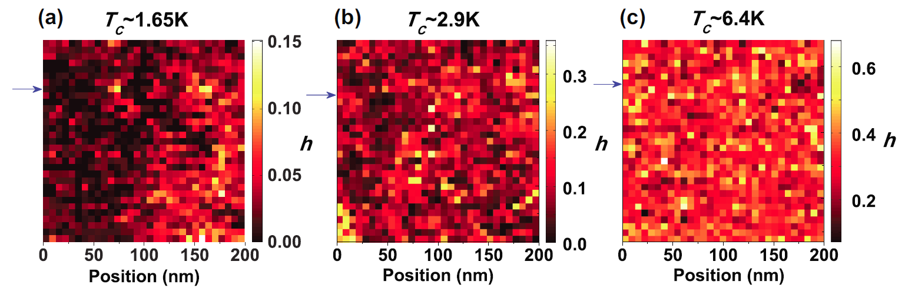
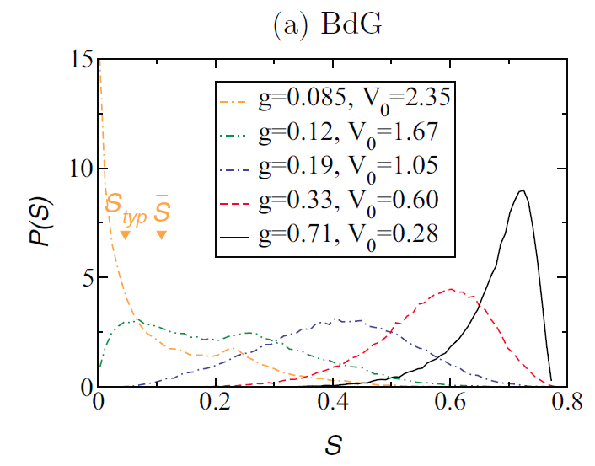
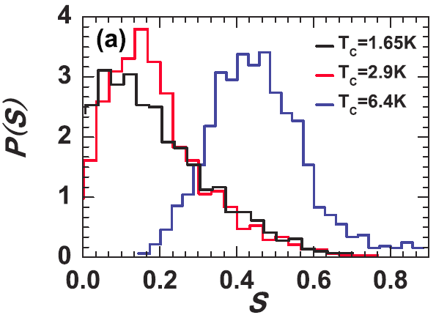
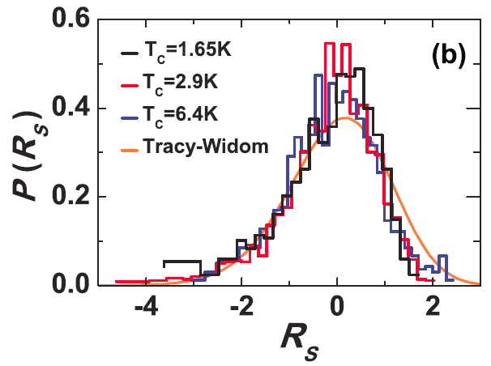

Slide 8
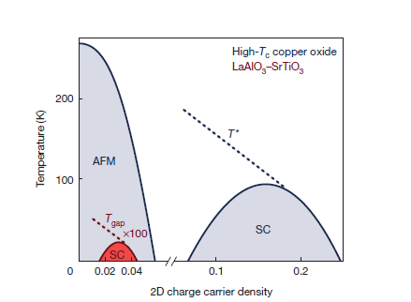
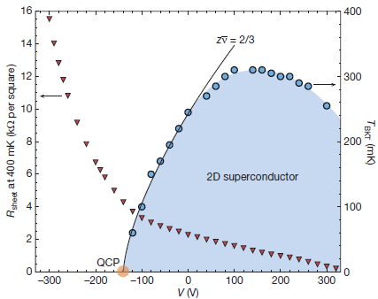
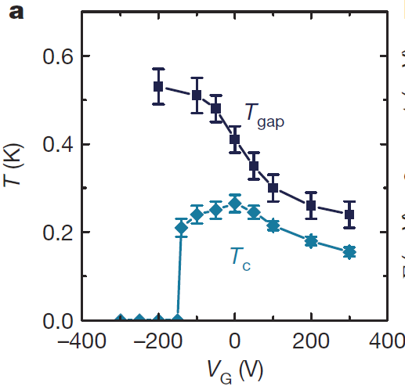
LaAlO₃ /SrTiO₃ mimics cuprates
Mannhart et al., Nature 502, 528 (2013)
Triscone et al. , Nature 456 624 (2008)
Control
Tunability

Slide 9
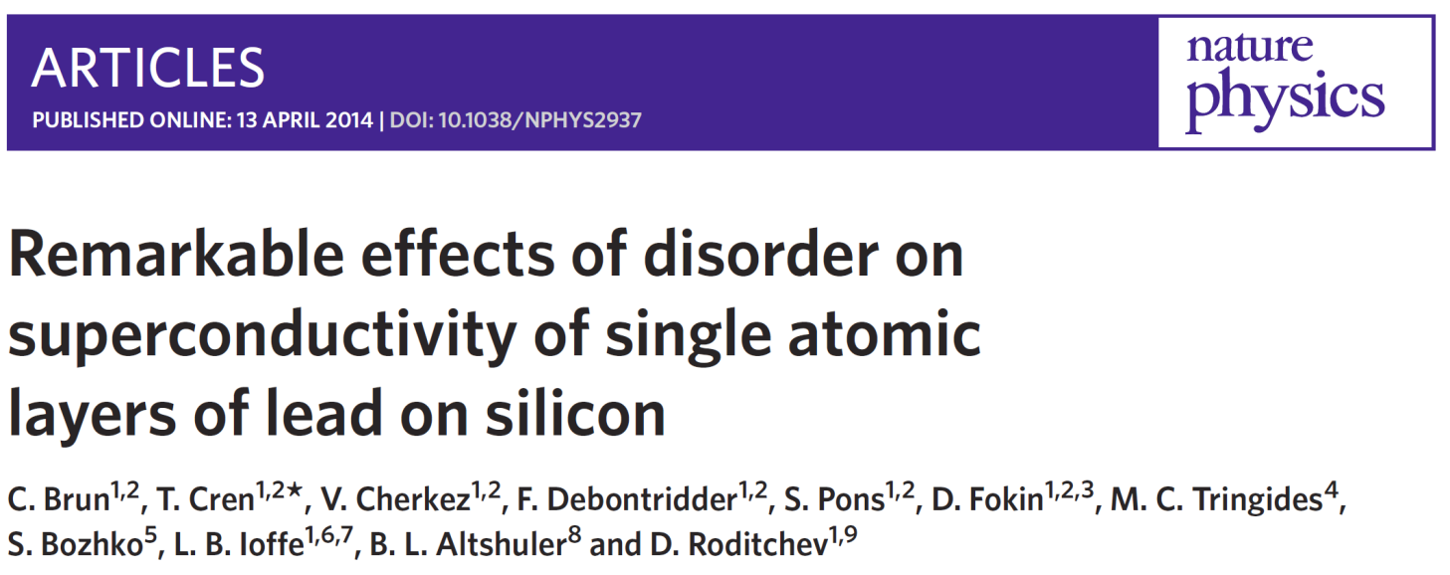
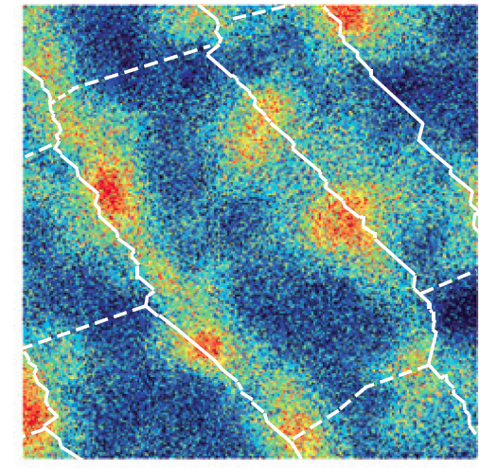
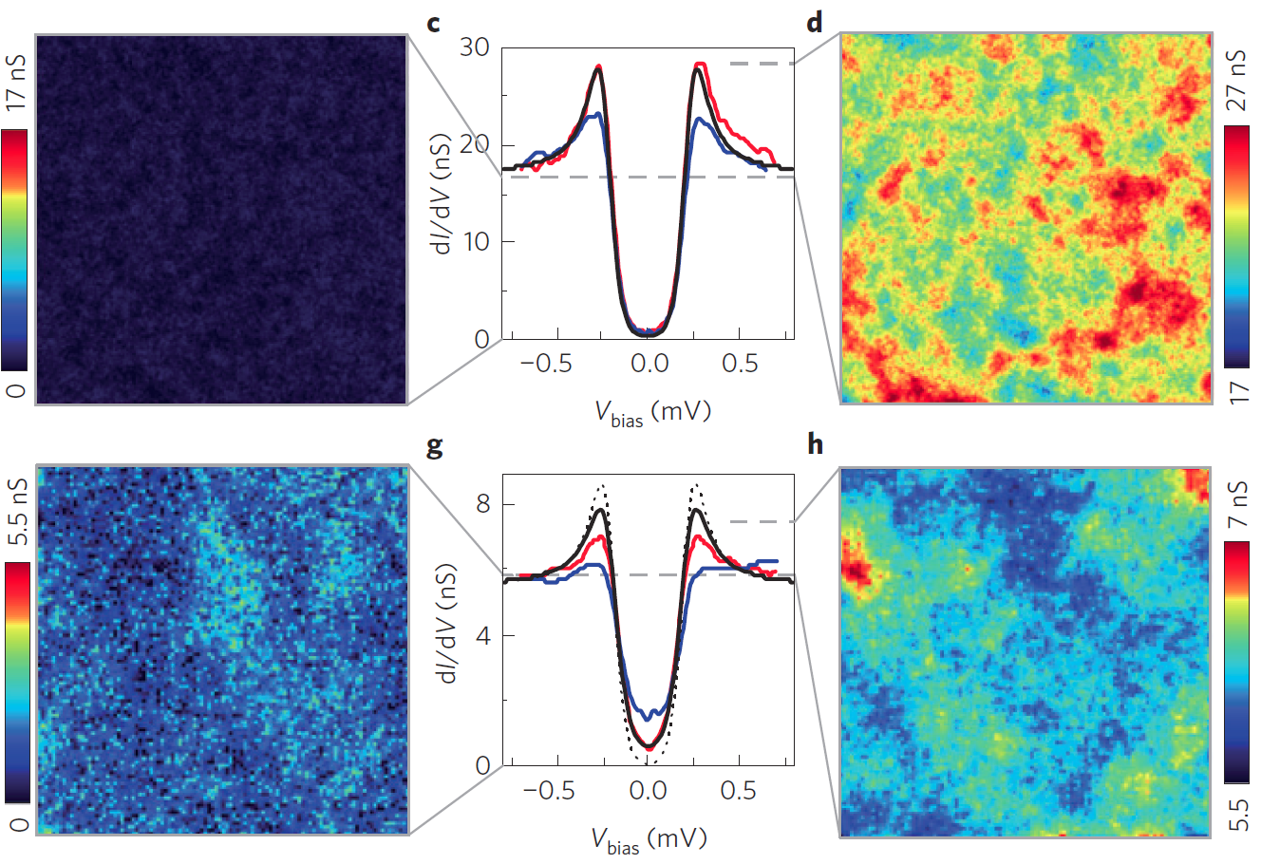

Slide 10
1. Superconductor becomes highly inhomogeneous
2. Pseudogap phase does exist and it is likely generic
3. T_{c} always decreases with disorder
4. Order parameter has a broad distribution in space
5. Likely the transition is bosonic for weak coupling

Slide 11

Inhomogeneities by disorder
Energy gap
Order parameter
$$Δ(r)$$
Theory?
Global T_{c}
Can disorder enhance superconductivity?

Slide 12
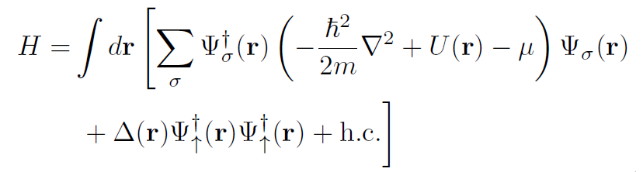
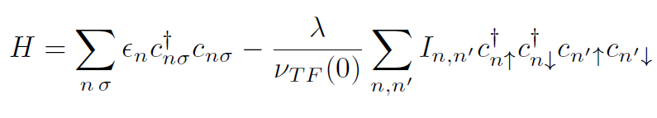

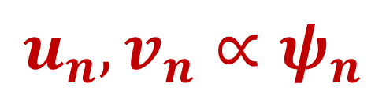
Some bad news
BdG too difficult
BCS doable
$$u_{n},v_{n}∝ψ_{n}$$
but valid only if

Slide 13
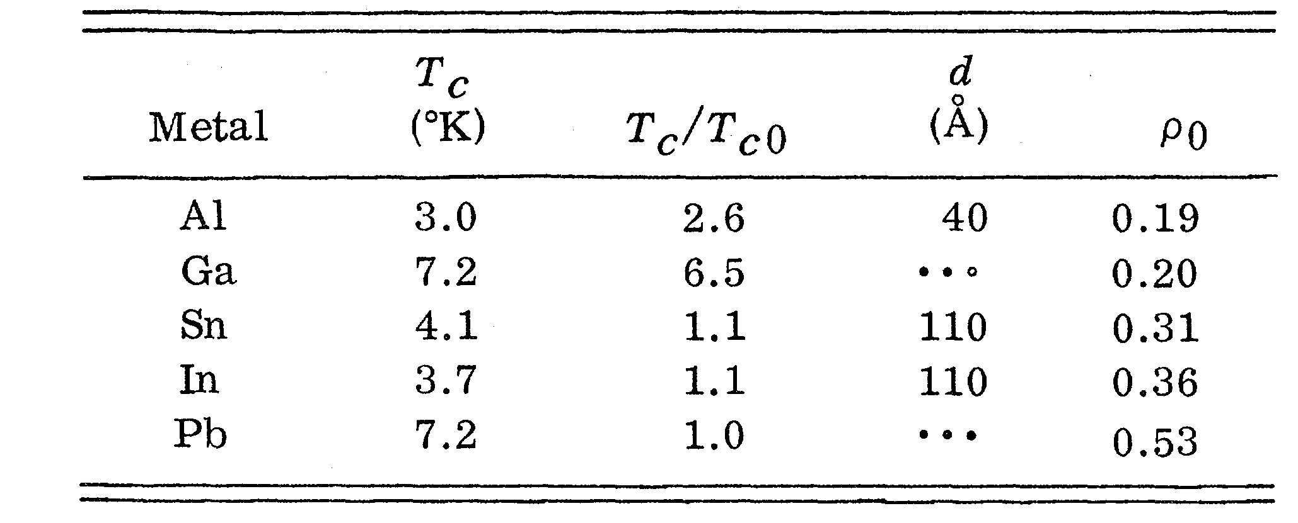
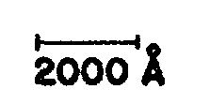
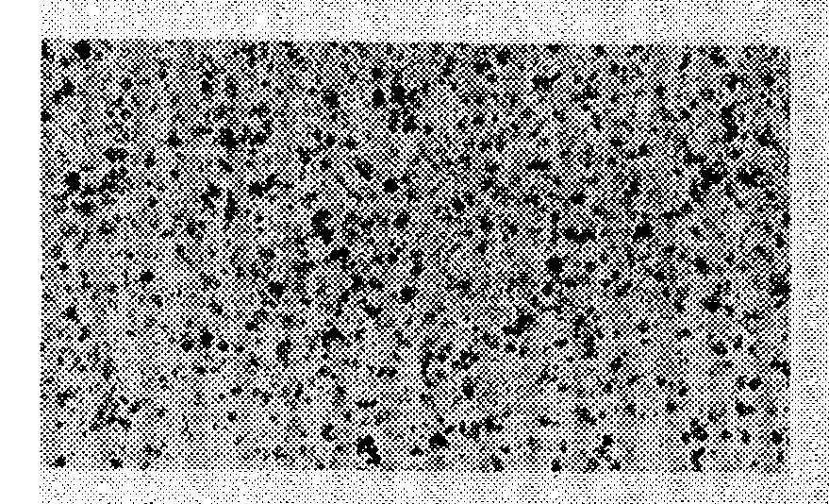
Some good news
Abeles, Cohen, Cullen, Phys. Rev. Lett., 17, 632 (1966)
1. Lower T_{c} for strongly coupled materials

Slide 14
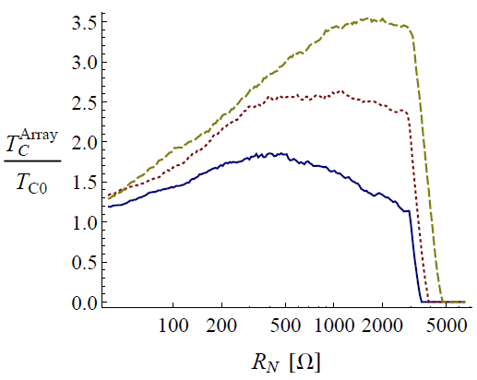


Engineering granular materials
Optimal but realistic
L ~ 5 nm
σ ~ 1nm
$$C≠1$$
$$λ≪1$$
T
Enhancement is possible
Mayoh, AGG., Phys. Rev. B 90, 134513 (2014)

Slide 15
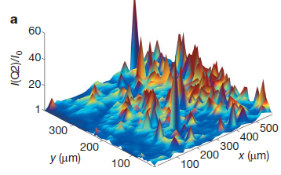
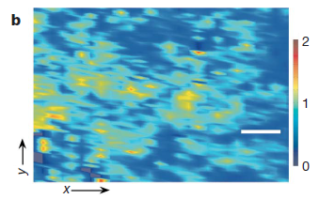
Enhancement of Tc by disorder
Fractal distributions of dopants enhance Tc in cuprates
Bianconi, et al., Nature 466, 841 (2010)
Inhomogeneities
Higher T_{c}
PRL 108, 017002 (2012)
PRL, 98, 027001 (2007)

Slide 16
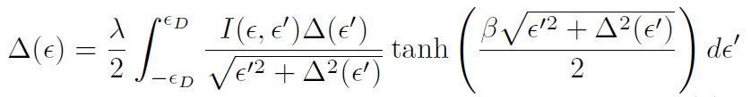
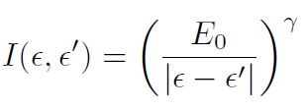



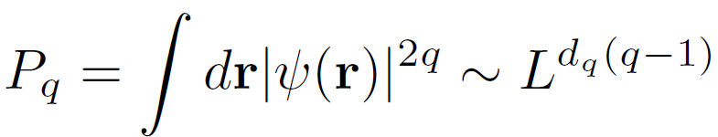

Too good news? Strong multifractality and superconductivity
Feigelman, Ioffe, Kravtsov, Yuzbashyan, Phys. Rev. Lett. 98, 027001 (2007)
I. S. Burmistrov, I. V. Gornyi, A. D. Mirlin, Phys. Rev. Lett. 108, 017002 (2012)
3D MIT
$$T_{c}≥1000K!$$
~ 0.4
Mean field?
Global T_{c} ?
Spatial distribution?

Slide 17
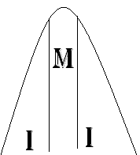
d = 1 An insulator for any disorder
d =2 An insulator for any disorder
d > 2 Disorder strong enough: Insulator
Disorder weak enough: Mobility edge
Metal Insulator Transition

Slide 18
Metal
Transition
Insulator
Multifractal
Wigner-Dyson statistics
Critical statistics
Poisson statistics

Slide 19
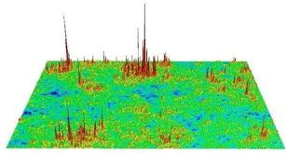
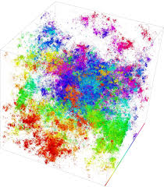
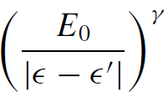
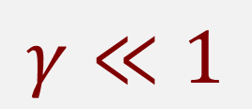
Anderson Metal-Insulator Transitions
Multifractal eigenstates
Wegner, Aoki, Castellani, Efetov
2 and 2+ε D
$$γ≪1$$
Weak multifractality
~

Slide 20


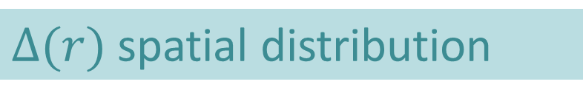
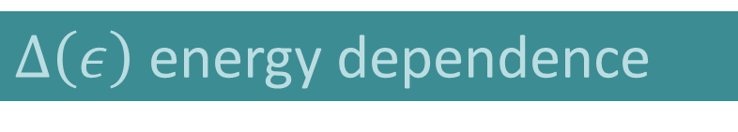


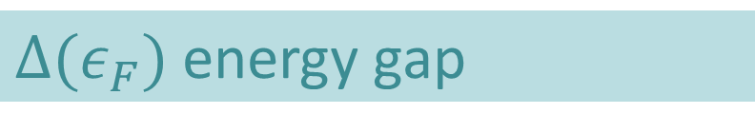
Weak multifractality and superconductivity
J. Mayoh and AGG, PRB 92 174526 (2015)
Where?
What?
(Ultra) Thin films
$Δ(ε_{F})$ energy gap
2D + Spin orbit
$Δ\left(ε\right)$ energy dependence
1D + Long Range
$Δ(r)$ spatial distribution
Approximations
Global T_{c}!
$$λ,γ≪1$$
Can disorder enhance SC?
$$BCS,ε_{D }fixed$$
Percolation

Slide 21
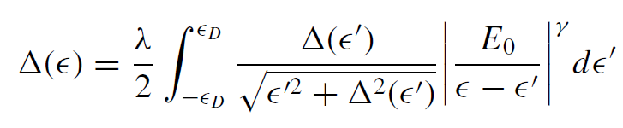




$$Δ_{γ}=Δ(ε_{F})$$
Unrealistic
Not true Tc
Inhomogenous SC

Slide 22



Energy dependence of $Δ(ε)$

Slide 23







Spatial Distribution
Eq.137, Feigelman M V, Ioffe L B, Kravtsov V E, Cuevas E, 2010 Ann. Phys. 325 1368
$$κ∼1/g$$
Universal log-normal distribution!

Slide 24




$$γ∼1/g$$
Global Tc?
Log-Normal distribution
Sacepe et al., Nat. Phys. 7 239 (2011)
Lemarie, Benfatto, et al., PRB 87, 184509 (2013)
Tracy-Widom?

Slide 25




Global T_{c}
Percolation
$$λ=0.25,0.3,0.4,0.5$$

Slide 26





Global T_{c}?
$$λ=0.25$$
$$φ\sim φ_{c}$$
$$φ_{c}=0.675,0.7,0.75,0.8$$
Enhancement?
$$λ≤0.3$$
Yes
But
Al is fine! FeSe/STO?

Slide 27



Enhancement of T_{c}!

Slide 28
1. Superconductor becomes highly inhomogeneous close to the transition
2. Pseudogap phase does exist and is generic
3. T_{c} not necessary decreases with disorder
4. Order parameter has a log normal
distribution in space for weak multifractality
5. Charging effects need to be considered
6. FeSe/STO, Tc ~ 100K and still is weak coupled

Slide 29
THANKS!

Slide 30


Engineering FeSe/STO
Interface design
Nano-granularity
Xue
Tsinghua
Enhancement of T_{c}
Xue et.al PRB B91 060509(R) (2015)

Slide 31




Slide 32
Can disorder enhance superconductivity?
Trivedi, Meir…..
Pratap, Sacepe…..
Numerics
Experiments
Strong coupling and disorder
Strong disorder and no weak coupling
AGG,Tezuka, 2011
Abeles,… 60’s
Gor'kov and Abrikosov
Finkelstein A M, 1987
Anderson theorem
Weak localization
Anderson, J. Phys. Chem. Solids 11, 26 (1959)
Maekawa S, Fukuyama H, 1982
Anderson theorem is all but a theorem
Be careful with BCS+Perturbation

Slide 33



